Slide 1


NODE.JS GLOBAL
Swagger.Docs
MARCH, 2019

Slide 2
Agenda
What is Swagger ?
Swagger specification
Swagger Tools
Design First vs Code First

Slide 3
What is Swagger ?
Specification
OpenAPI

Slide 4
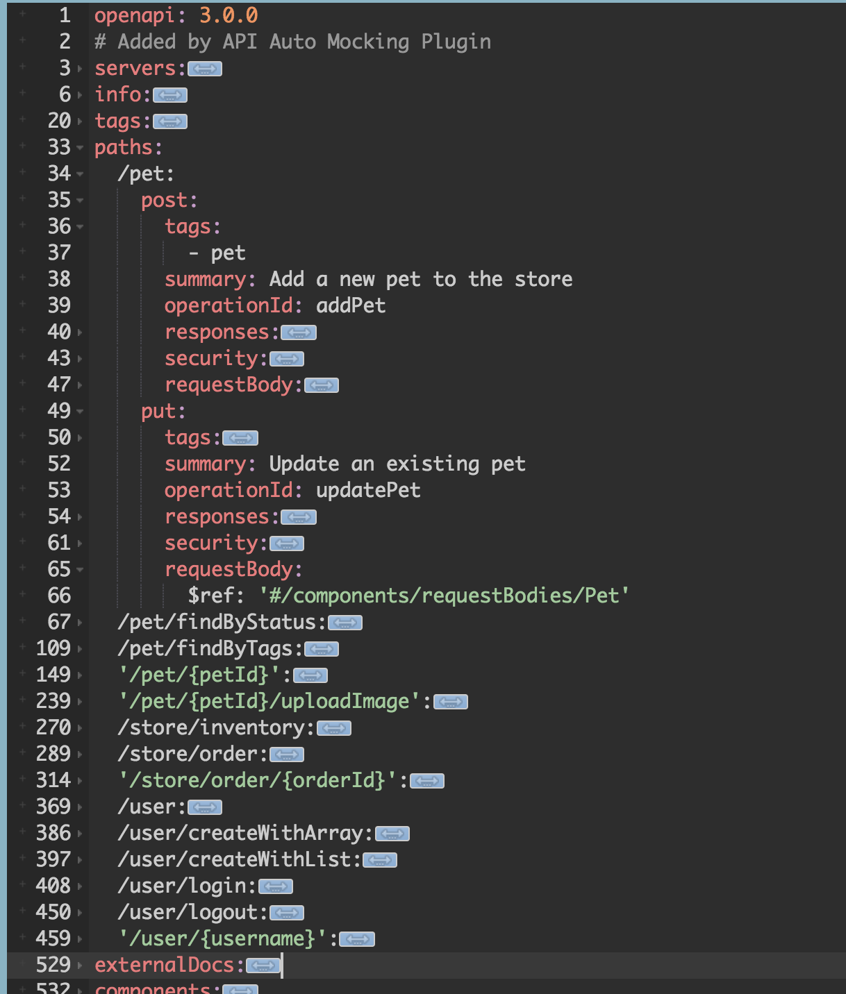
Swagger specification

Slide 5
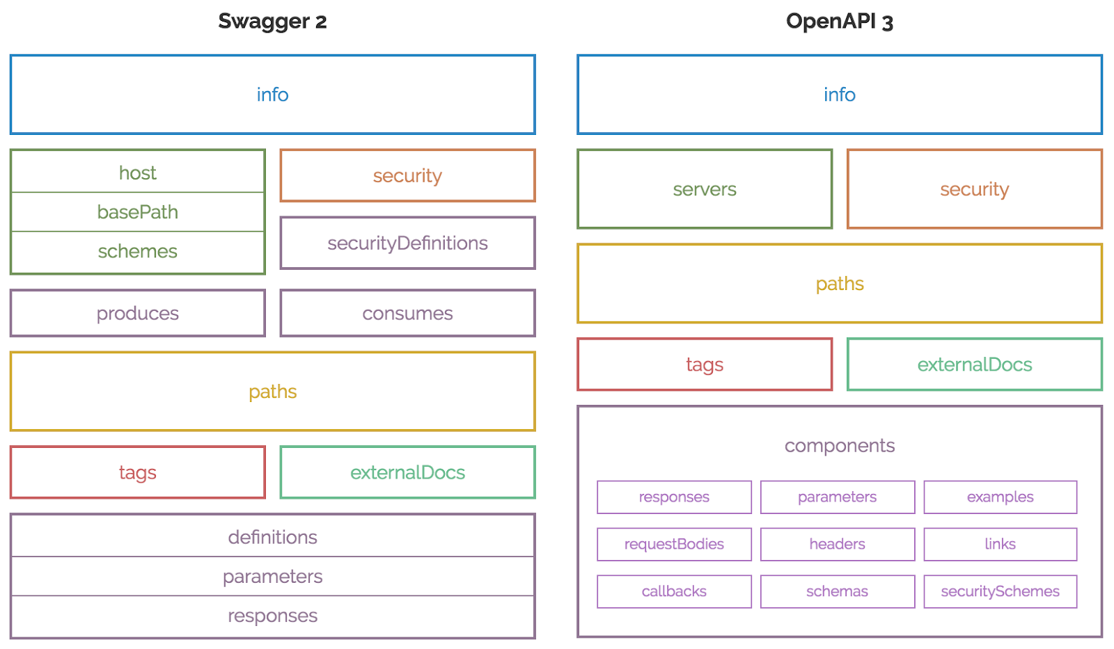
Swagger specification

Slide 6
Swagger specification
General information about the API
Available paths (/resources)
Available operations on each path (get /resources)
Input/Output for each operation

Slide 7
Swagger Tools
Swagger UI
Swagger Editor
Swagger HUB

Slide 8
Swagger Tools.UI
Swagger UI is a collection of HTML, Javascript, and CSS assets that dynamically generate beautiful documentation.
Example: http://petstore.swagger.io

Slide 9
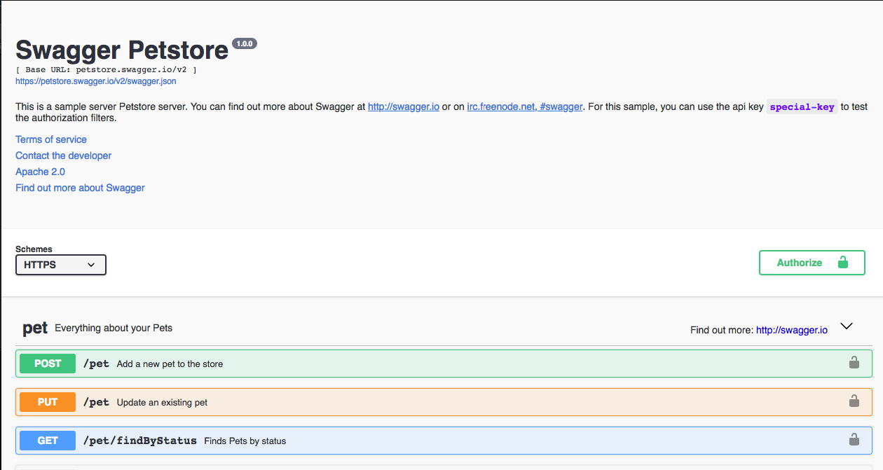
Swagger Tools.UI

Slide 10
Swagger Tools
The Swagger Editor is an open source editor to design, define and document RESTful APIs in the Swagger Specification.

Slide 11
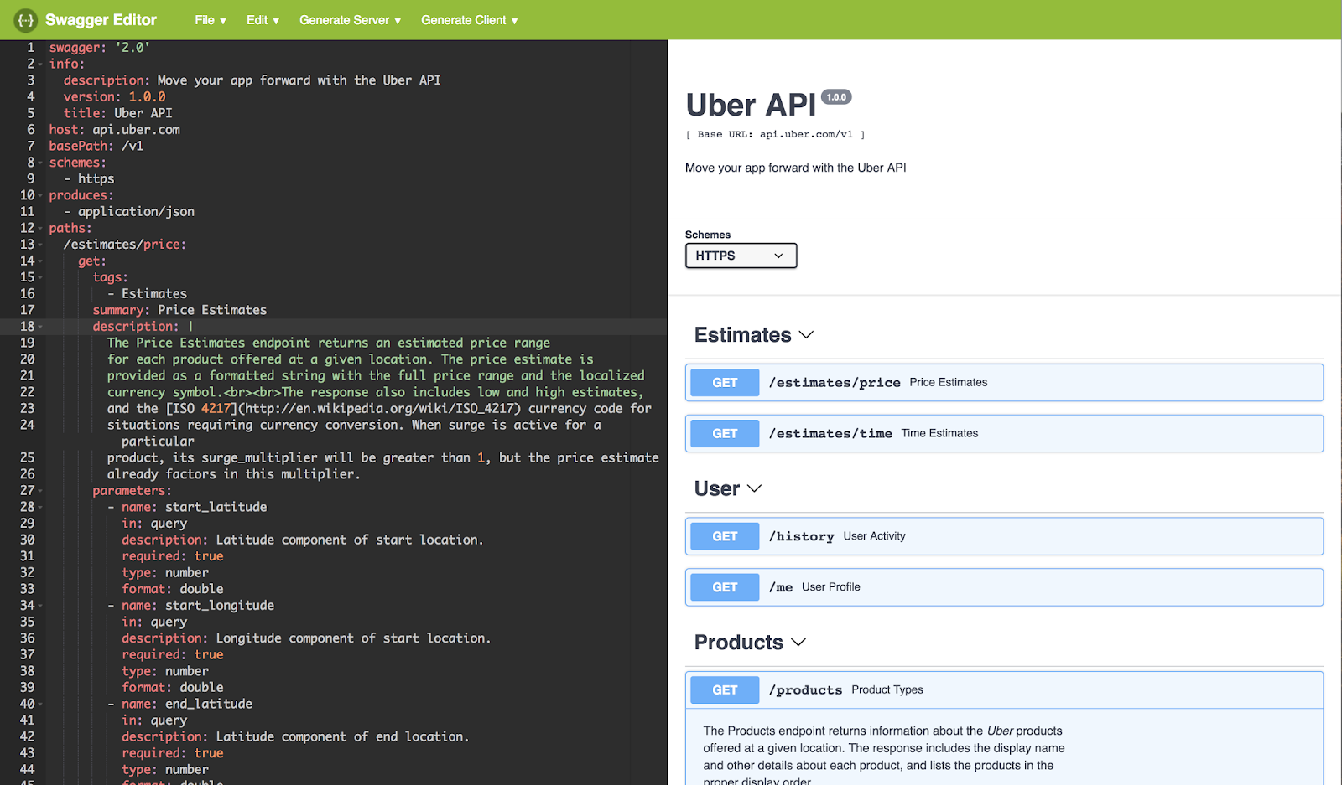
Swagger Tools.Editor

Slide 12
Swagger Tools.HUB
SwaggerHub provides a complete solution for designing, managing, and publishing documentation for your API

Slide 13
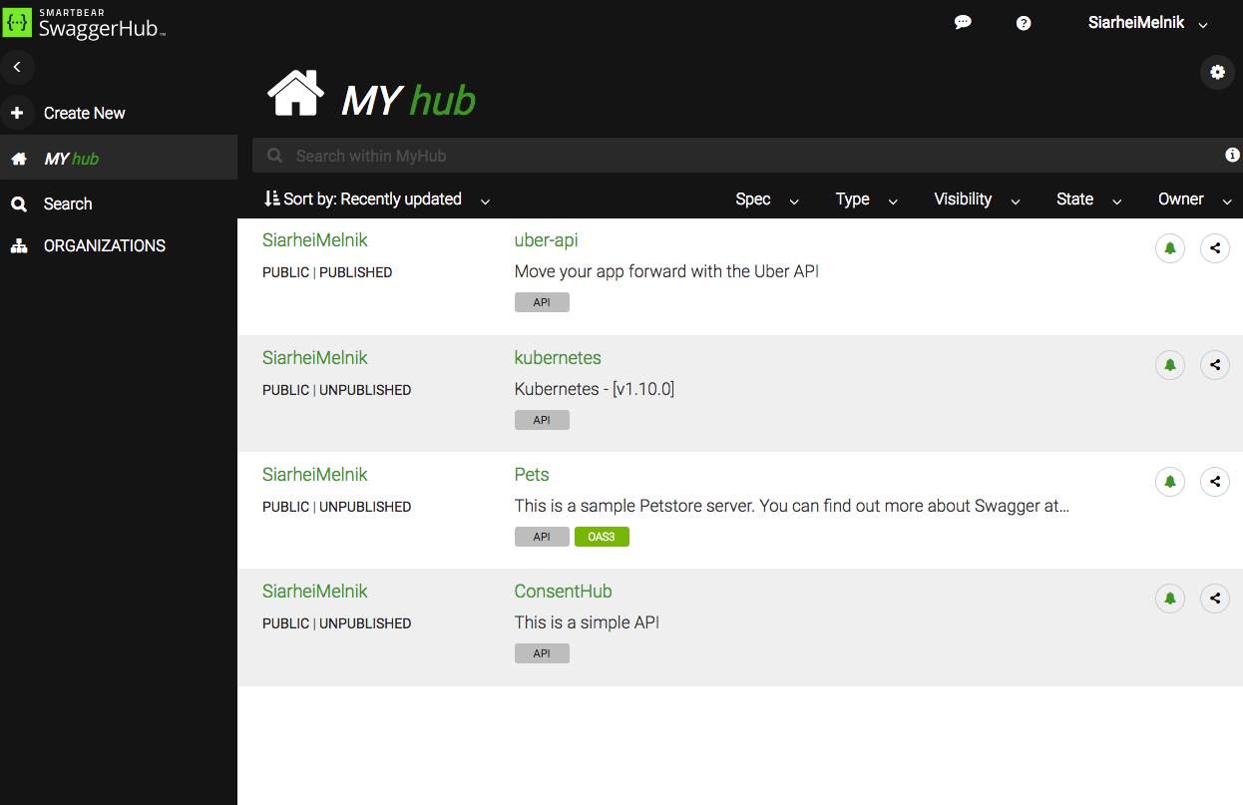
Swagger Tools.HUB

Slide 14
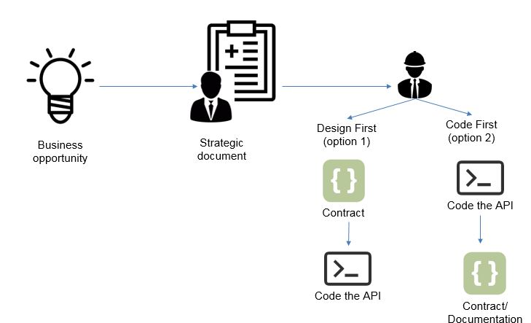
Design First vs Code First

Slide 15
Design First
Developer experience matters
Deliver mission critical APIs
Ensuring good communication

Slide 16
Code First
Delivery speedy matters
Developing Internal APIs

Slide 17
Swagger BY Siarhei Melnik
NODE.JS GLOBAL

